Slide 1
PHOTO ELECTRIC EFFECT
Name of the instructor: U.Nithya M.Sc.,M.Phil.,

Slide 2
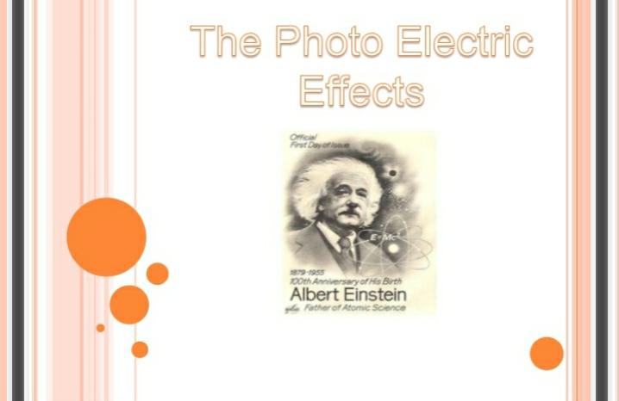

Slide 3
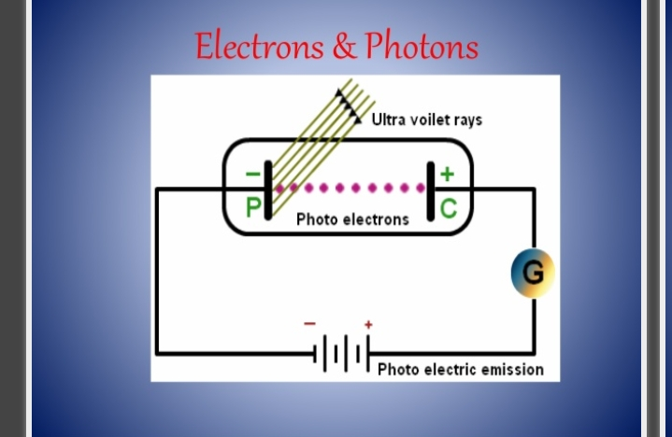

Slide 4
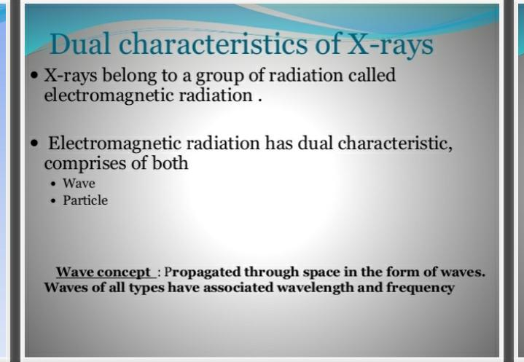

Slide 5
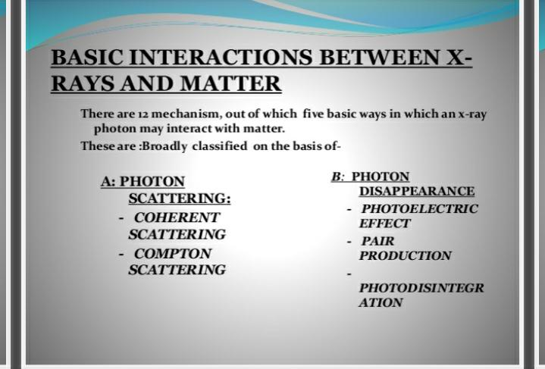

Slide 6
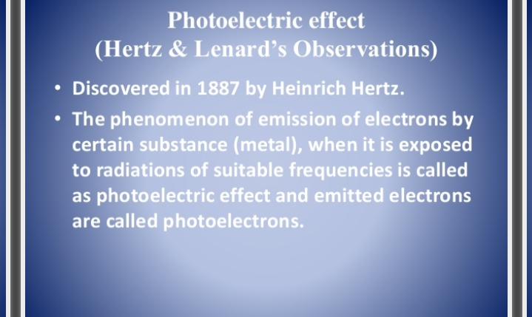

Slide 7
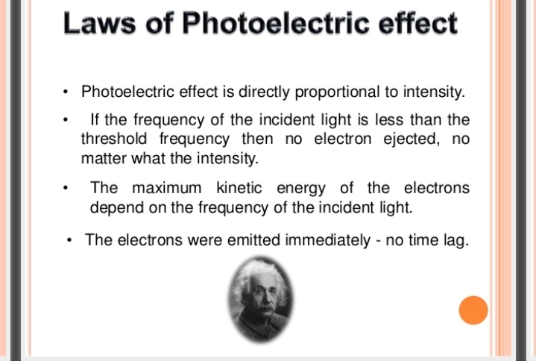

Slide 8
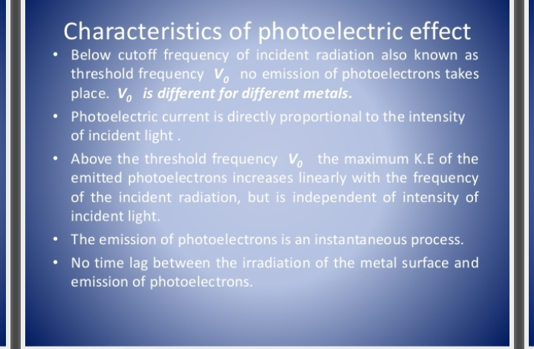

Slide 9
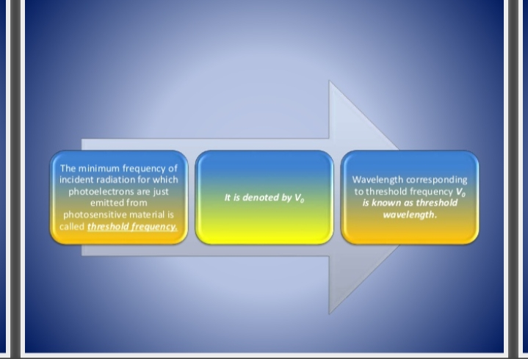

Slide 10
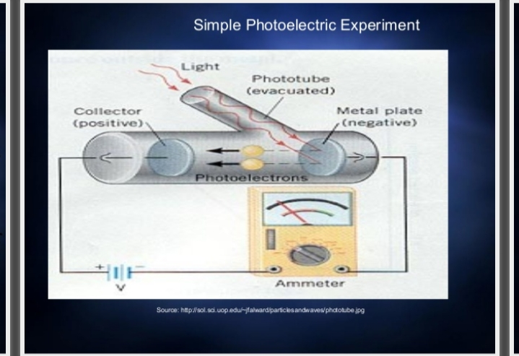

Slide 11
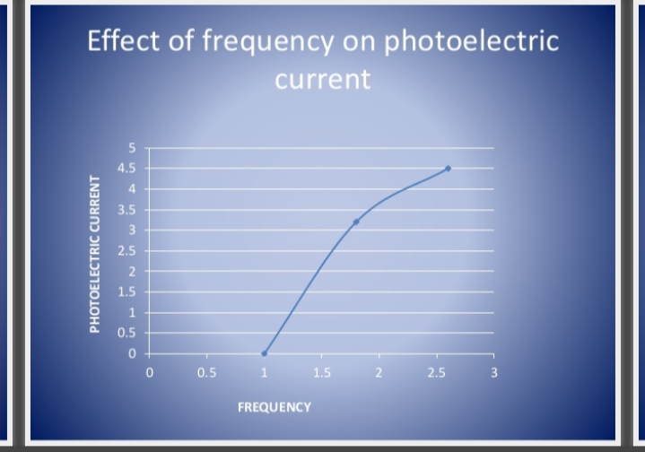

Slide 12
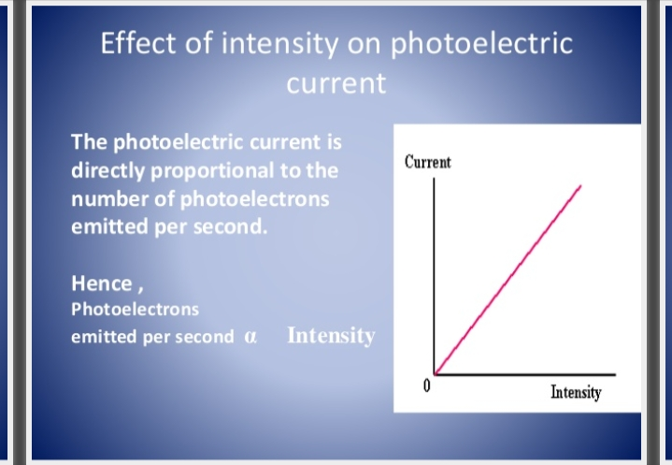

Slide 13
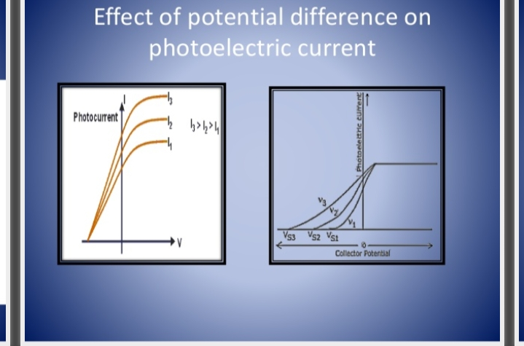

Slide 14
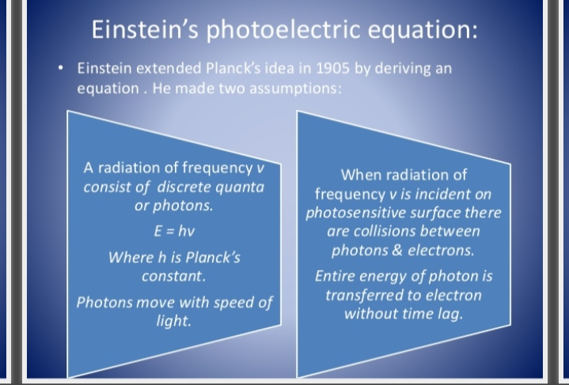

Slide 15
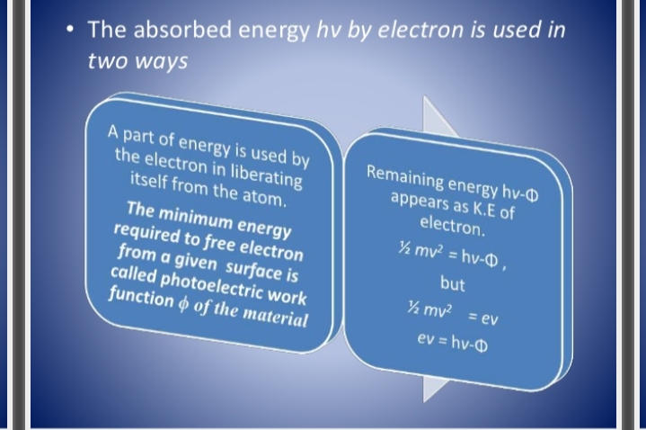

Slide 16
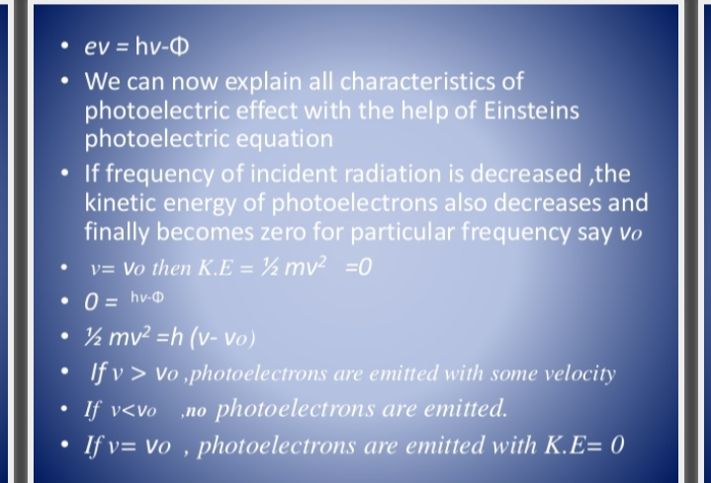

Slide 17
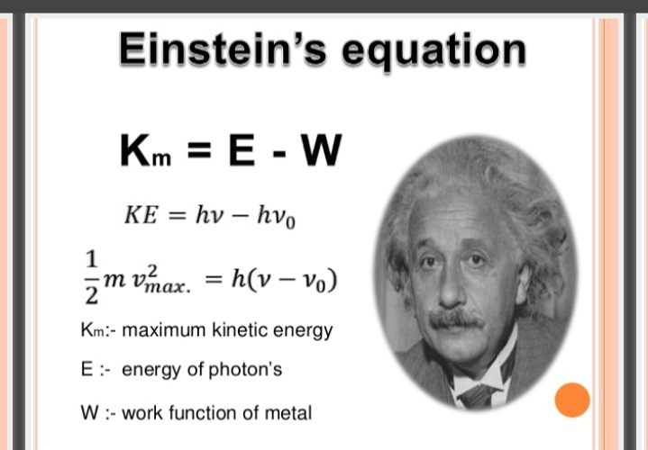

Slide 18
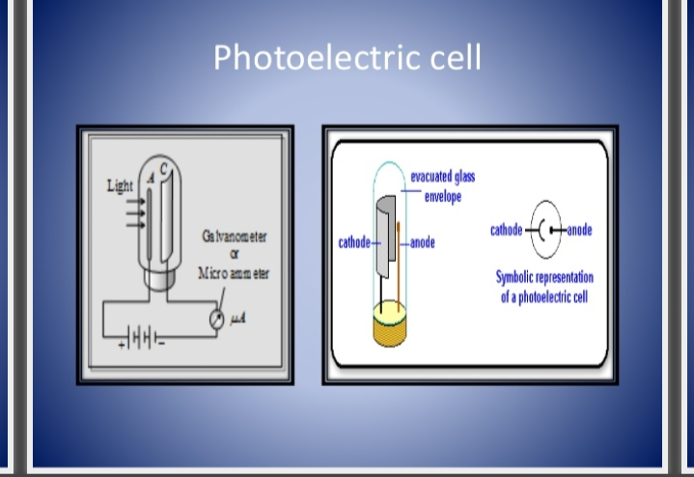

Slide 19
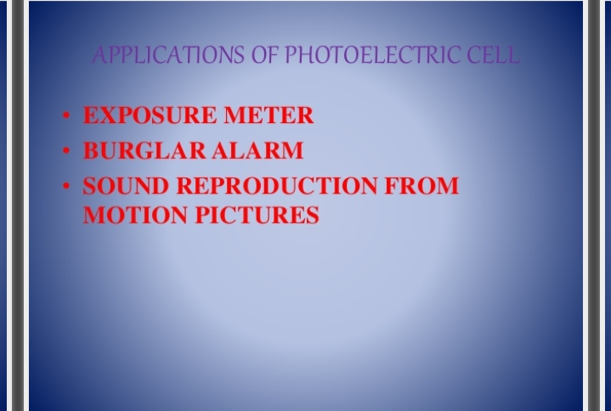

Slide 20
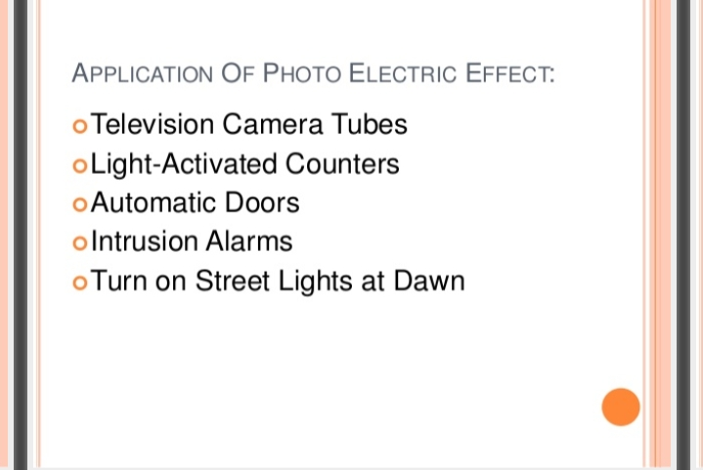

Slide 21
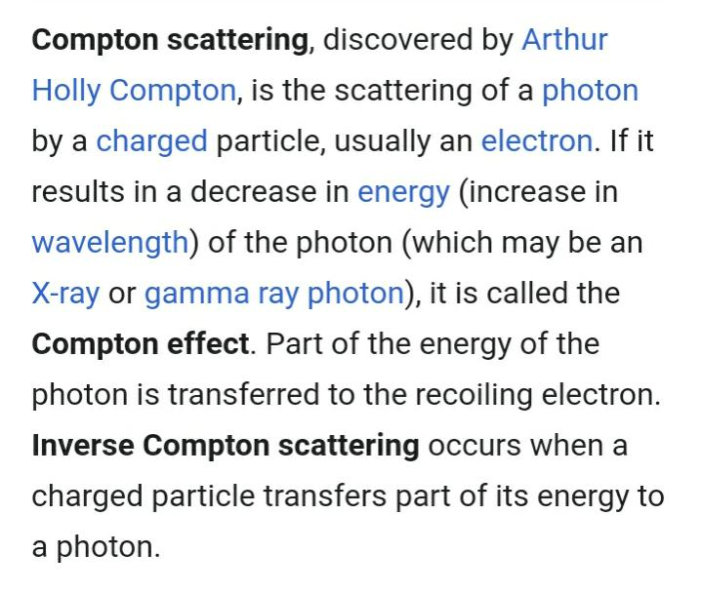

Slide 22
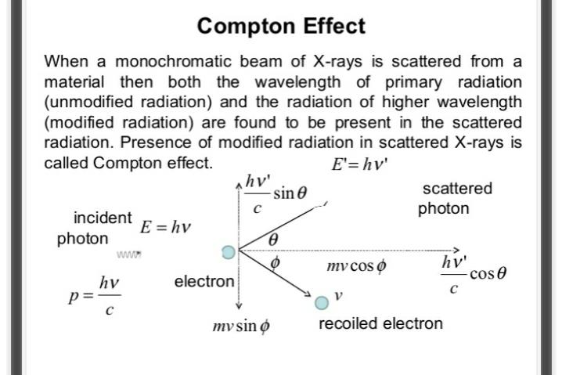

Slide 23
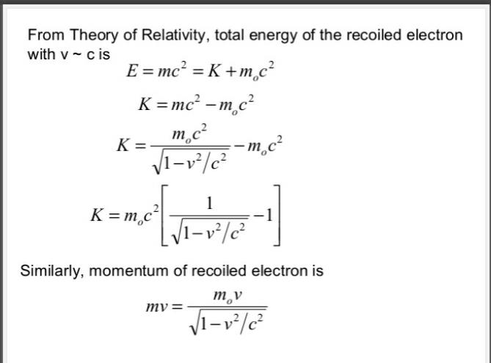

Slide 24
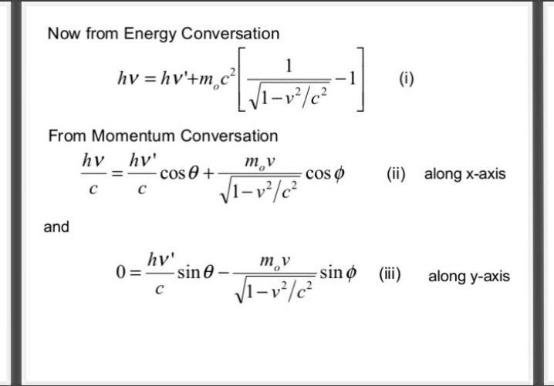

Slide 25
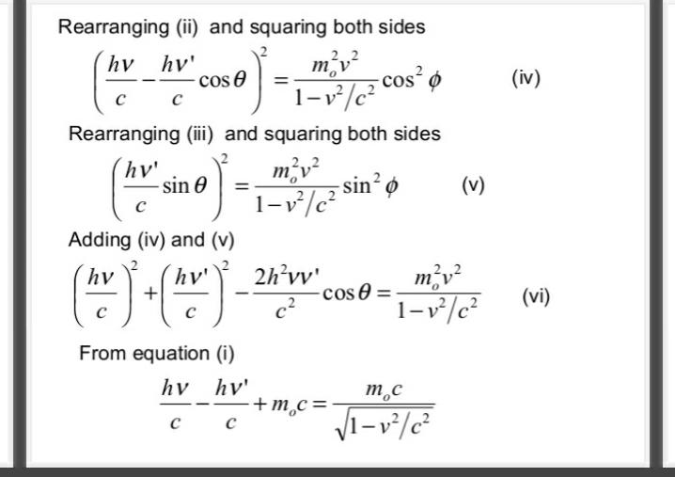

Slide 26
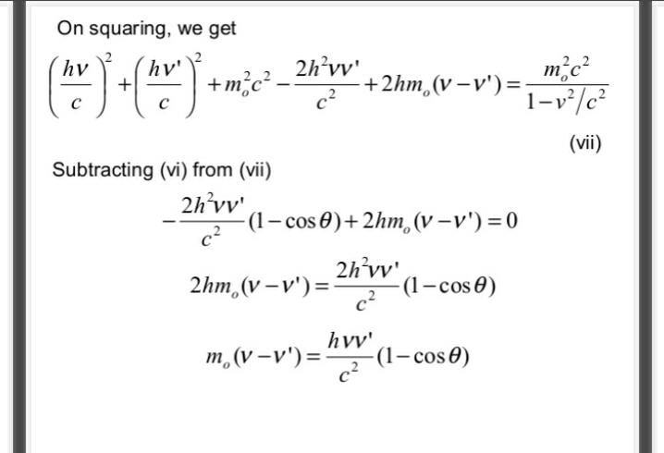

Slide 27
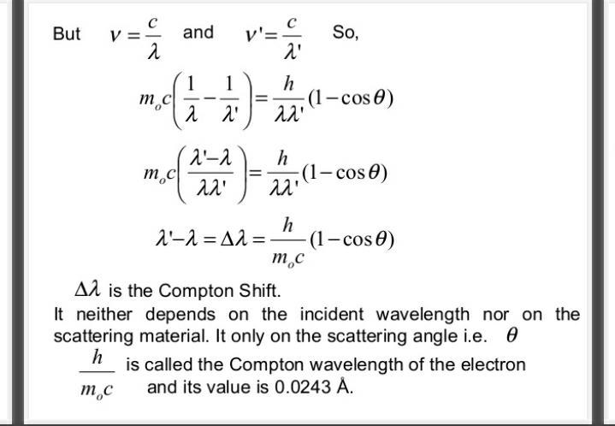

Slide 28
A photon hits an electron,depending on the energy of the hitting photon any one of the following three situations may arise.
If the energy of the photon is less than the nuclear forces of attraction for the electron the nucleus will hold the electron ie the electron will not be ejected
If the energy of photon is some what more than the nuclear forces of attraction for the electron then the forces of attraction would be overcome.The electron would be ejected
If the energy of photon is suffiently more than the nuclear forces of attraction for the electron.Then the forces of attraction would become insignificant and the electron would behave as if they were completely free.

Slide 29
Compton suggested that
If the collision is a head on collision the electron would be ejected at high speed in the direction of the impact. The x-ray photons would lose a large fraction of energy and will be deflected through a large angle from its origional path.
If the collision is a side wise collision the x-ray photon would lose less energy and it will be deflected through much smaller and angle from its origional path.
If the collision is a mere touch the x-ray photon would lose less only little energy and will not be deflected from its origional path.

Slide 30
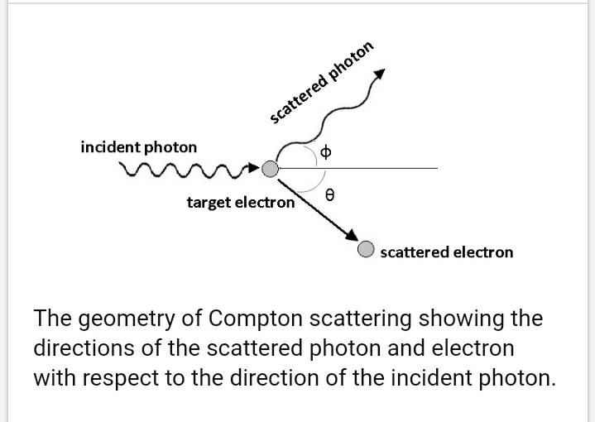

Slide 31
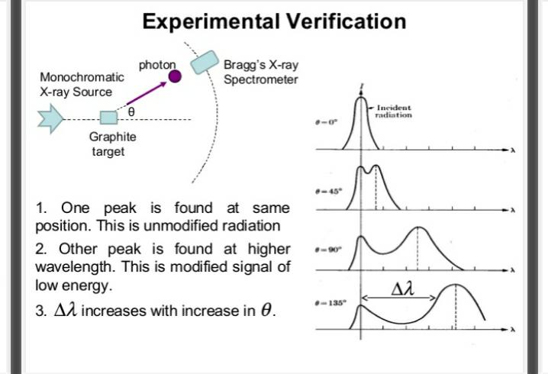

Slide 32
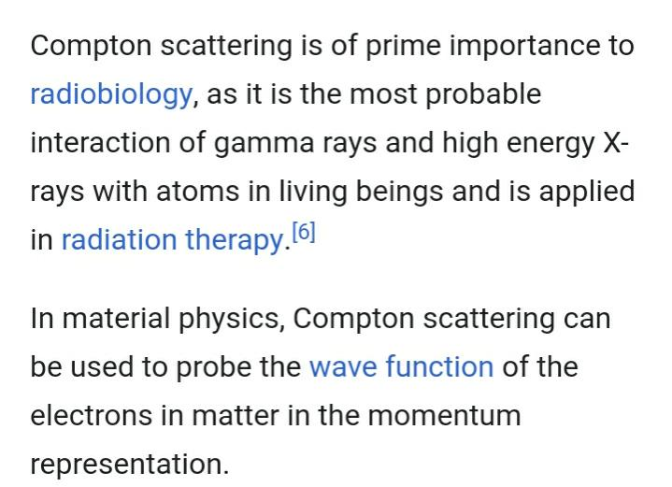
Applications

Slide 33
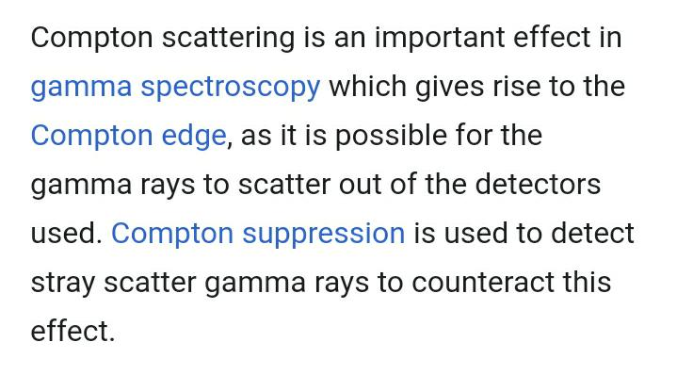

Slide 34
THANK YOU

